Slide 1
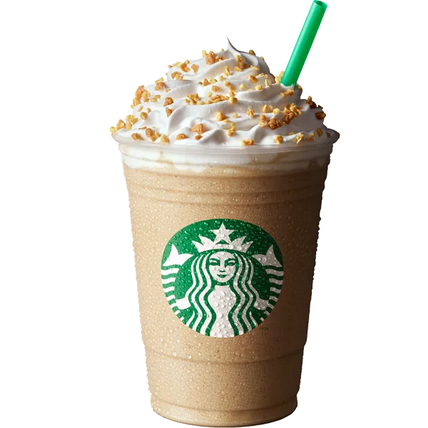
Group - 4
Aspect-Based Sentiment Analysis on Starbucks Reviews
CSCE 5290 Natural Language Processing
Team Members:
Deepu Gondhi - 11737274
Kaushik Apoori - 11705023
Manumitha Kamarapu - 11684243
Teena Poorna Sudheera Maganti - 11755850

Slide 2

Introduction
Goal: Analyze sentiment in Starbucks customer reviews to find areas that need work.
Applications:
Determine the main areas where the client experience can be improved.
Offer insights to improve operational effectiveness.

Slide 3
Problem Statement and Motivation
Problem: Analyzing client feedback by hand is inefficient due to its large volume.
Motivation:
It is challenging for the business to effectively extract relevant insights from the vast amount of review data gathered from consumer feedback.
Traditional techniques, such manually examining feedback, take a lot of time and run the risk of overlooking important trends or patterns.
Actionable insights for improving customer satisfaction and operational effectiveness are provided by automated analysis.

Slide 4
Significance and Objectives
Significance:
It helps Starbucks make focused changes by determining the areas of unhappiness or by comprehending the sentiment of the client regarding service quality and operation.
helps Starbucks make adjustments that are specifically needed.
Objectives:
Determine opinions about things like price, product, and service.
Put NLP models into practice for sentiment analysis.
At least 80% classification accuracy should be attained.
Gather insights that can be put to use.

Slide 5
Feedback and Improvements
Feedback Summary:
Integration with Information Extraction: Improve the extraction of pertinent information from customer reviews by using sophisticated NLP models such as RoBERTa (Robustly Optimized BERT Pre Training Approach) and BERT (Bidirectional Encoder Representations from Transformers). These models can extract important elements like service quality, product features, and price more precisely since they can comprehend context at a higher level.
Enhancements:
Sentiment Analysis with Transformer Models: To improve the accuracy of classifying sentiments (positive, negative, and neutral), the code now incorporates sentiment analysis driven by transformer-based models (such as BERT and RoBERTa). These models perform better by comprehending the context and subtle language of customer evaluations, leading to more accurate sentiment classification.

Slide 6
Methodology Overview - Workflow & Architecture
Workflow Diagram:
Step 1: Loading the Starbucks Data
Step 2: Preprocessing the Reviews
Step 3: Extracting Features
Step 4: Training the Model
Step 5: Predicting the Sentiments
Step 6: Evaluating the Results
Step 7: Results through Visualizations

Slide 7
Methodology Overview - Workflow & Architecture
Architecture Diagram
Data Collection
Data Preprocessing
Feature Extraction
Sentiment Classifier
Results

Slide 8
Dataset
Dataset Description: Starbucks Reviews Dataset (741 reviews) collected from Consumer Affairs.
Code used for uploading dataset:
Attributes:import pandas as pan
df = pd.read_csv('/content/reviews_data.csv')
print(df.head())
Name: The name of the reviewer.
Location: The city or location associated with the reviewer.
Date: Date when the review was posted.
Rating: Rating given by the reviewer, out of five stars.
Review: The text of the review capturing the reviewer's experience.
Image Links: Links to any images attached to the review, if available.

Slide 9
Features
Technical Aspects:
Identify sentiments around specific aspects of the Starbucks experience, such as:
Service quality
Product taste
Store ambiance
Pricing
Incorporate Aspect-Based Sentiment Analysis (ABSA).
NLP Techniques:
Identify recurring themes, keywords, and patterns in consumer evaluations.
Emphasize areas of praise or problems that are often brought up.
Sentiment Analysis:
Visualize consumer feedback from several retail locations by performing sentiment analysis and mapping them spatially.
Determine local problems and regional patterns.

Slide 10
Data Preprocessing
Preprocessing Steps:
Handle missing values.
df.dropna(subset=['Review', 'Rating'], inplace=True)
Remove URLs, special characters, punctuation.
import re
def preprocess_text(text):
text = re.sub(r'http\S+|www\S+|https\S+', '', text)
text = re.sub(r'\@\w+|\#', '', text)
text = re.sub(r'[^\w\s]', '', text)
text = text.lower()
return text
df['Cleaned_Review'] = df['Review'].apply(preprocess_text)
This line ensures that the data we deal with is complete by eliminating any rows that lack the "Review" or "Rating" fields.
Eliminate URLs: The regex eliminates URLs, such as http://example.com.
Eliminate Mentions and Hashtags: Eliminates any evaluations that contain @mentions or #hashtags.
Eliminate Punctuation: This removes punctuation from the evaluations, such as periods and commas.
Lowercase: Standardizes all text by converting it to lowercase.

Slide 11
Data Preprocessing
Preprocessing Steps:
Lemmatization and stopword removal.
import nltk
from nltk.corpus import stopwords
from nltk.stem import WordNetLemmatizer
nltk.download('stopwords')
nltk.download('wordnet')
lemmatizer = WordNetLemmatizer()
stop_words = set(stopwords.words('english'))
def preprocess_text_advanced(text):
text = ' '.join(lemmatizer.lemmatize(word) for word in text.split() if word not in stop_words)
return text
df['Cleaned_Review'] = df['Cleaned_Review'].apply(preprocess_text_advanced)
Timestamp Transformation: Convert review dates for analysis.
df['Date'] = df['Date'].str.replace('Reviewed ', '')
df['Date'] = pd.to_datetime(df['Date'], format='%b %d, %Y', errors='coerce')
print(df[['Date', 'Cleaned_Review']].head())
Lemmatization is the process of reducing words to their most basic form, such as "better" -> "good" or "running" -> "run."
Stopword Removal: Eliminates terms that don't contribute much significance to the review, such as "the," "is," and "in."
In the 'Date' column, the "Reviewed" prefix is removed.
Convert to datetime: To enable easier analysis, this function transforms a date from a string into a datetime object in the format supplied (for example, "Nov 06, 2024").

Slide 12
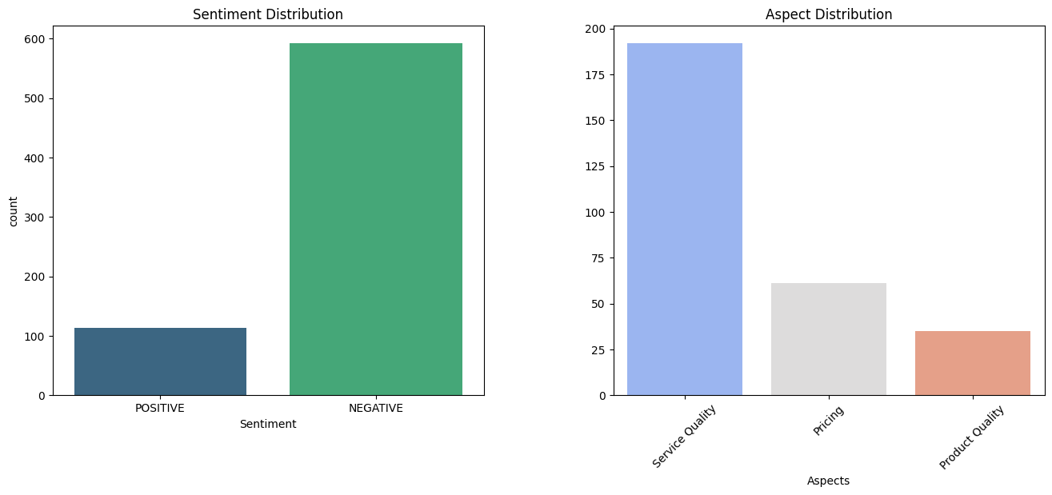
Exploratory Data Analysis (EDA)
EDA Visualizations:
Sentiment Analysis: Countplot showing distribution of sentiments (positive, negative, neutral).
Aspect Analysis: Barplot showing frequency of mentioned aspects (e.g., service, price, product quality).
Visualizations will be generated from the code output in the colab

Slide 13
Implementation Details
Pipeline for Sentiment Analysis: Libraries Matplotlib and Seaborn were used for visualizations, pandas, numpy, nltk for preprocessing, and transformers (for sentiment analysis).
Steps in the Code:
Data preprocessing: Lemmatization, punctuation, URLs, and special characters are eliminated to clean and prepare text data.
Sentiment Analysis: Classifies the sentiment of each review using a transformer model.
Aspect Extraction: Relevant elements, such as service and product, are extracted using keywords.

Slide 14
Implementation Details
Data Preprocessing: Eliminates URLs, special characters, punctuation, and lemmatization to clean and prepare text data.
import pandas as pan
import re
import nltk
from nltk.corpus import stopwords
from nltk.stem import WordNetLemmatizer
nltk.download('stopwords')
nltk.download('wordnet')
df = pd.read_csv('/content/reviews_data.csv')
df.dropna(subset=['Review', 'Rating'], inplace=True)
lemmatizer = WordNetLemmatizer()
stop_words = set(stopwords.words('english'))
def preprocess_text(text):
text = re.sub(r'http\S+|www\S+|https\S+', '', text)
text = re.sub(r'\@\w+|\#', '', text)
text = re.sub(r'[^\w\s]', '', text)
text = text.lower()
text = ' '.join(lemmatizer.lemmatize(word) for word in text.split() if word not in stop_words)
return text
df['Cleaned_Review'] = df['Review'].apply(preprocess_text)
df['Date'] = df['Date'].str.replace('Reviewed ', '') # Remove 'Reviewed ' prefix
df['Date'] = pd.to_datetime(df['Date'], format='%b %d, %Y', errors='coerce')
print(df[['Date', 'Cleaned_Review']].head())
Remove URLs: To eliminate URLs from the reviews, use regex.
Eliminate Mentions and Hashtags: Eliminates hashtags and mentions (like @user).
Eliminate Punctuation: This method purifies the text by eliminating punctuation elements.
Text is converted to lowercase for consistency.
Eliminating common words that don't add value (like "the" and "is") and lemmatizing words to their root form (like "running" -> "run") are two examples of stopword removal and lemmatization.

Slide 15
Implementation Details
Sentiment Analysis: Uses a transformer model to classify each review's sentiment.
from transformers import pipeline
sentiment_analyzer = pipeline('sentiment-analysis')
df['Sentiment'] = df['Cleaned_Review'].apply(lambda x: sentiment_analyzer(x)[0]['label'])
print(df[['Cleaned_Review', 'Sentiment']].head())
Sentiment Analysis: Sentiment analysis is utilized through the transformers pipeline. "POSITIVE" and "NEGATIVE" are examples of the attitudes that the model automatically categorizes from the cleaned review text.
Each cleansed review's row has the sentiment analysis applied by the apply() function.

Slide 16
Implementation Details
Aspect Extraction: Keywords are used to extract relevant aspects like service and product.
def extract_aspects(review):
aspects = []
if 'service' in review:
aspects.append('Service Quality')
if 'product' in review:
aspects.append('Product Quality')
if 'price' in review:
aspects.append('Pricing')
return aspects
df['Aspects'] = df['Cleaned_Review'].apply(extract_aspects)
Aspect Extraction: This straightforward function assigns pertinent aspects to the review (such as "Service Quality" and "Product Quality") and determines whether specific keywords (such as "service," "product," or "price") occur in the review.
Aspects for every review are extracted using the apply() function.

Slide 17
Results and Insights
Performance Metrics:
Achieved accuracy and F1-score of sentiment classification.
Expected Results:
Sentiment Distribution
Aspect Distribution
Insights:
Graphs will provide actionable insights, e.g., trends in service satisfaction or dissatisfaction by location.
Graphs to be generated from EDA code output.
insights = {
'1': 'Improve service quality by training staff based on customer feedback.',
'2': 'Expand product offerings based on popular customer preferences.',
'3': 'Enhance store ambiance to improve customer experience.',
'4': 'Adjust pricing strategies based on customer feedback on pricing.',
'5': 'Focus on locations with high dissatisfaction to improve overall ratings.'
}

Slide 18
Insights and Recommendations
Important Takeaways:
Enhancement of Services Needed: Poor service quality reviews draw attention to problems with order correctness and responsiveness.
Product Improvement: According to consumer feedback, there is a need for more options that are in line with customer preferences and better product consistency.
Suggestions:
Service: Improve employee education and expedite service procedures.
Product: Pay attention to regularity and experiment with new menu items based on consumer preferences.

Slide 19
Project Management - Team Tasks
S.No | Name | ID | Task
1. | Deepu Gondhi | 11737274 | Sentiment analysis model integration.
2. | Kaushik Apoori | 11705023 | Preprocessing and aspect extraction.
3. | Manumitha Kamarapu | 11684243 | Data visualization and EDA.
4. | Poorna Sudheera Maganti | 11755850 | Final reporting and insights generation.
Challenges:
Addressing missing information, eliminating redundancies, and deriving useful conclusions.

Slide 20
References
Dataset: Starbucks Reviews Dataset from Kaggle
https://www.kaggle.com/datasets/harshalhonde/starbucks-reviews-dataset
Github: https://github.com/kaushikapoori/Group_4_NLP

